Slide 1
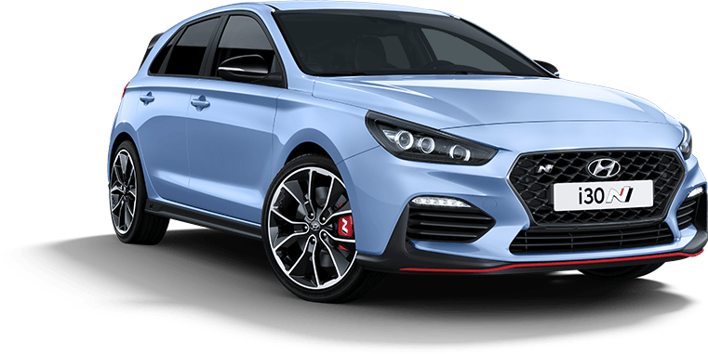
Foam Defect Catalog
Hyundai Tucson TLe
Hyundai i30
PDe

Slide 2
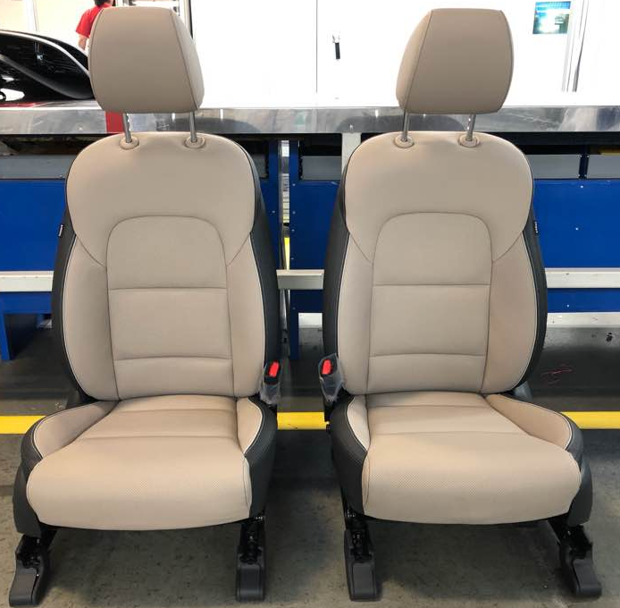
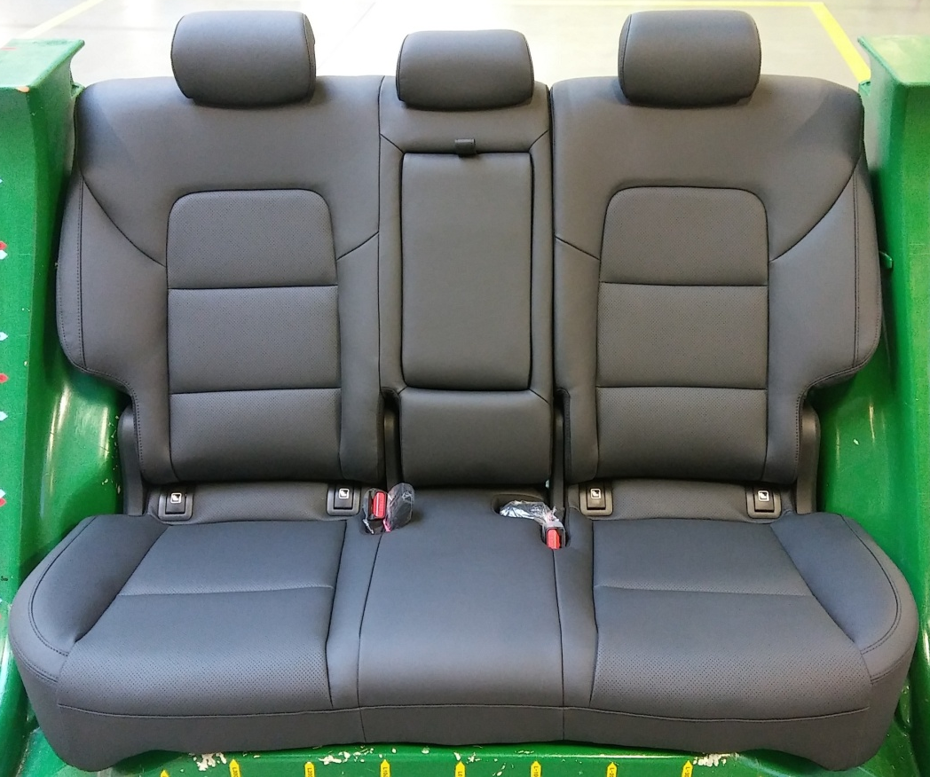
TLe
Foam Defect Catalog
Front
Rear
Project

Slide 3
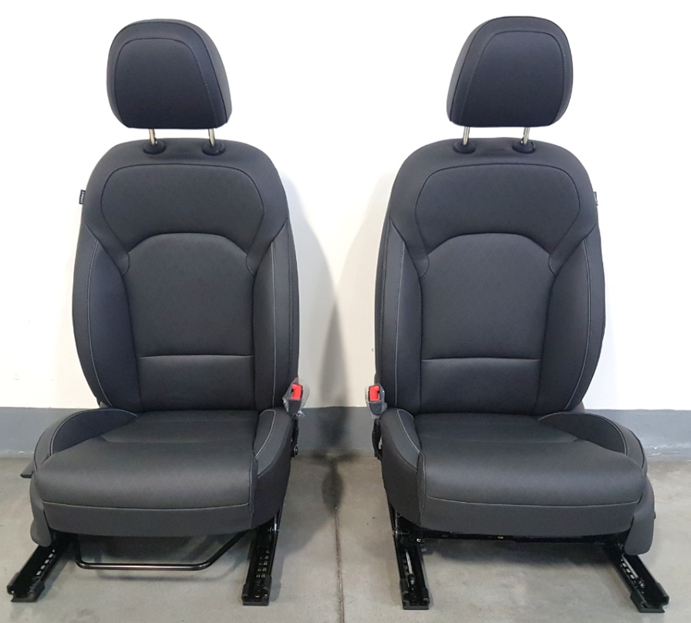
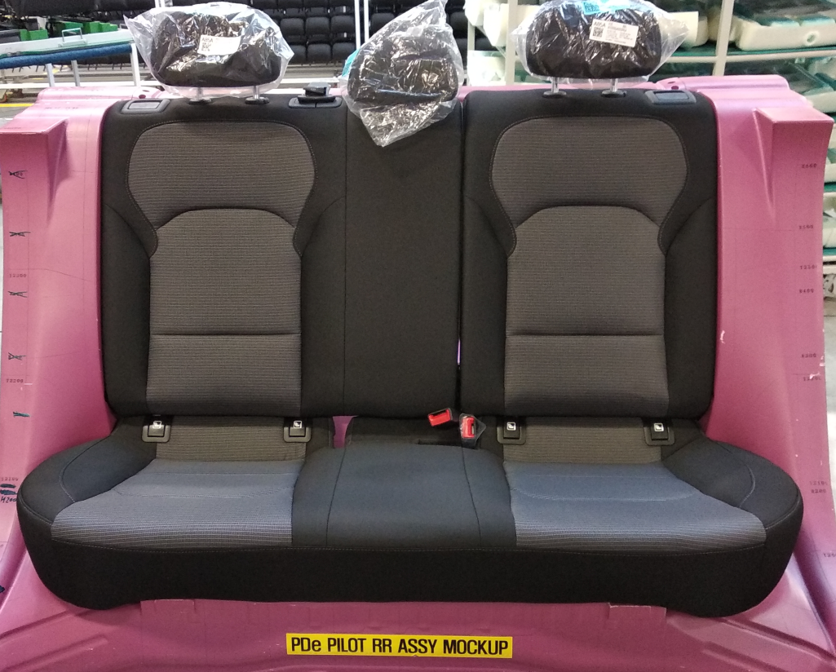
PDe
Foam Defect Catalog
Front
Rear
Project

Slide 4
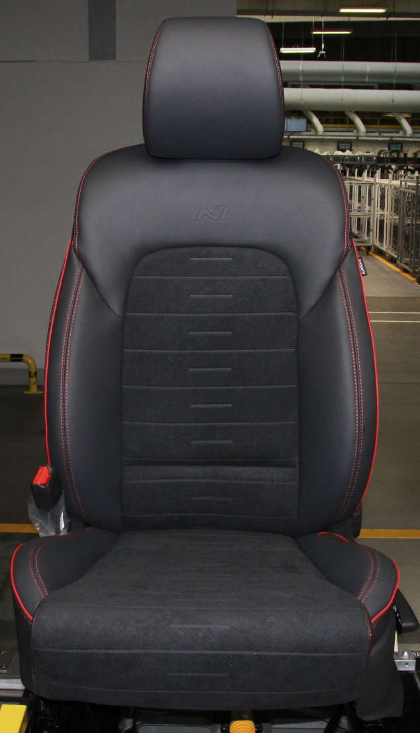
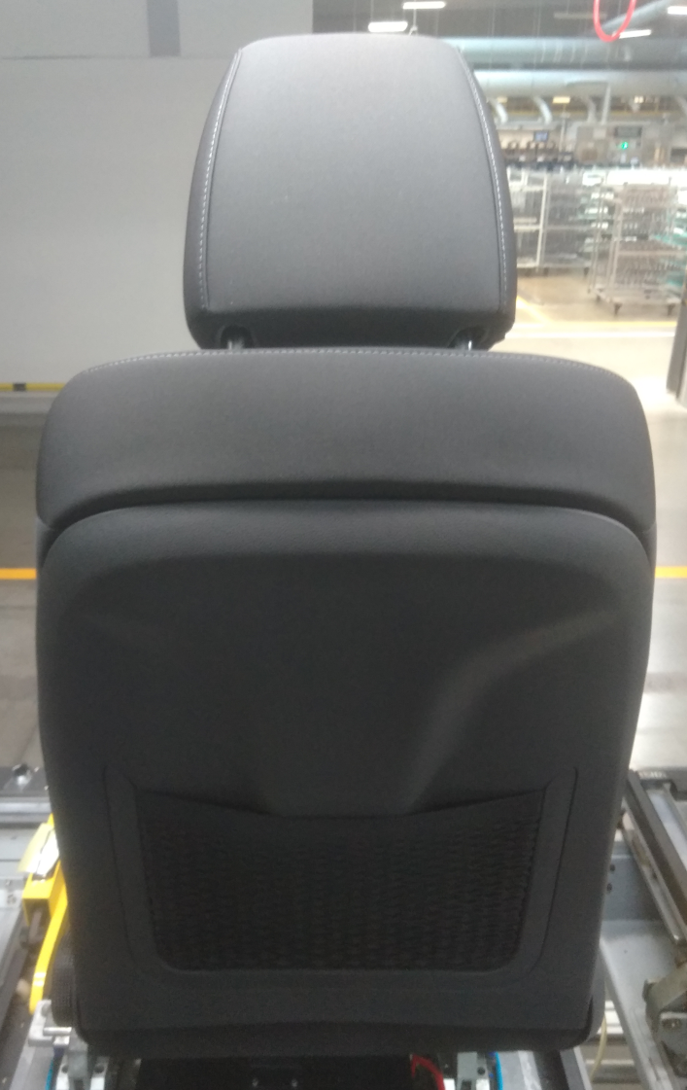
TLe Front
Foam Defect Catalog
A
B
B
B
A
B
D
C
D
D
D
Equipment
C
Project
TLe

Slide 5
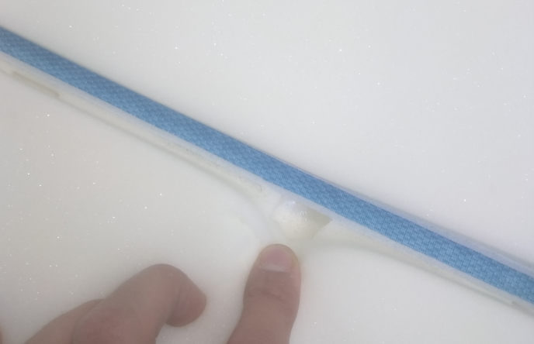
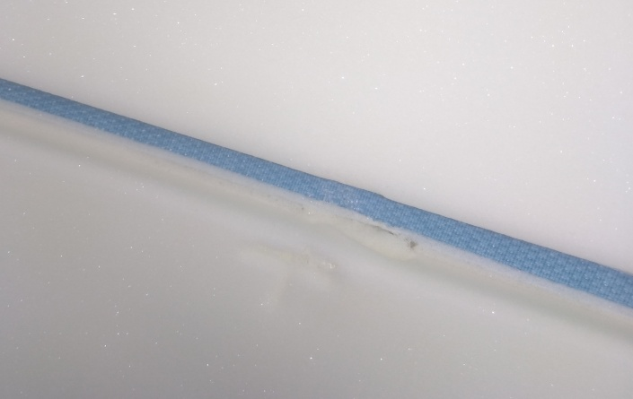
TLe Front→ ZONE A
Foam Defect Catalog
A-1
Defect reason | RP-02 Missing material
Size H/W/D [mm] | 15/25/15
Manifestation | Hole when cover is used
Repair
NG
NG
OK
TLe Front
Project
A
1
2
3
4
TLe

Slide 6
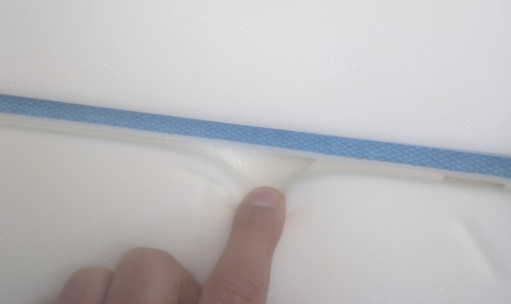
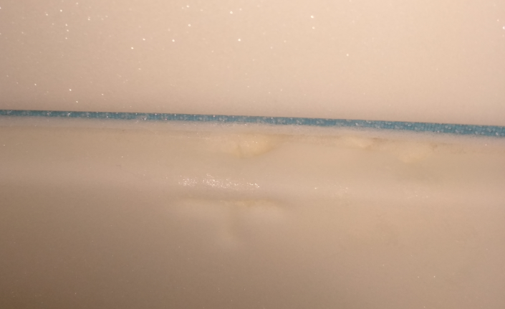
TLe Front→ ZONE A
Foam Defect Catalog
A-2
Defect reason | RP-02 Missing material
Size H/W/D [mm] | 10/20/20
Manifestation | Hole when cover is used
Repair
NG
OK
TLe Front
Project
A
1
2
3
4
TLe

Slide 7
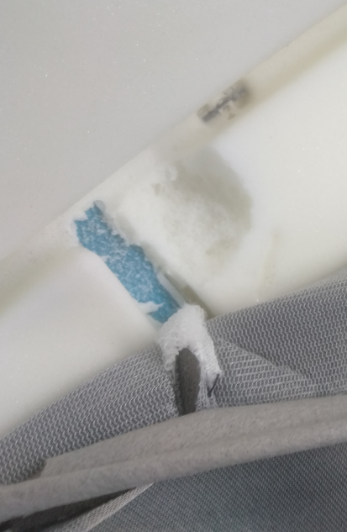
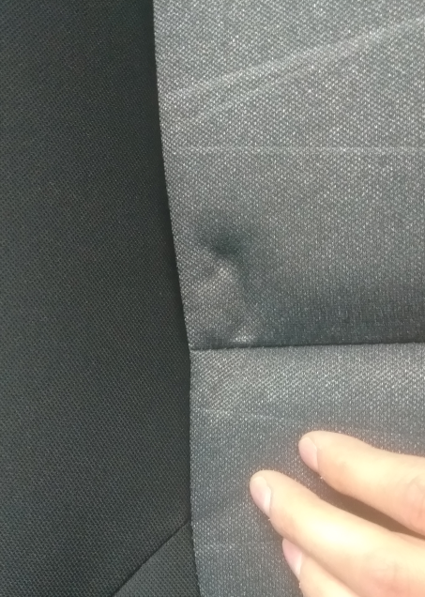
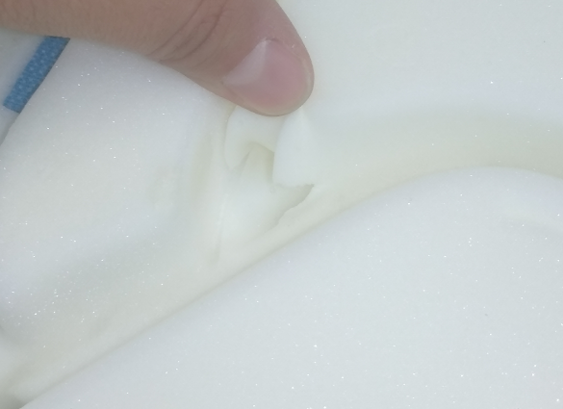
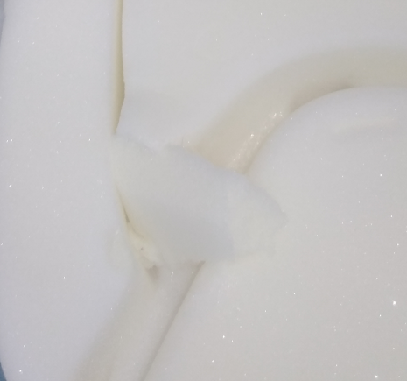
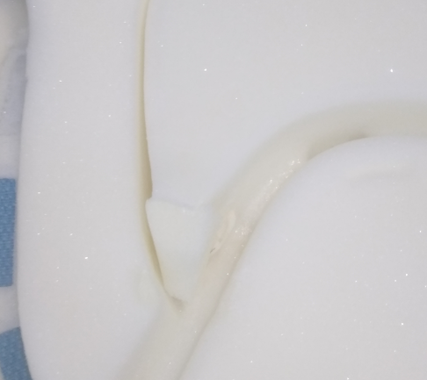
TLe Front→ ZONE A
Foam Defect Catalog
A-3
Defect reason | RP-02 Missing material
Size H/W/D [mm] | 15/15/20
Manifestation | Hole when cover is used
Repair
NG
NG
OK
TLe Front
Project
A
1
2
3
4
TLe

Slide 8
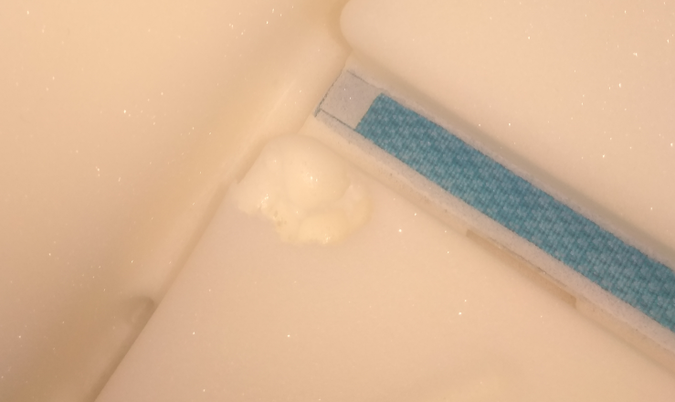
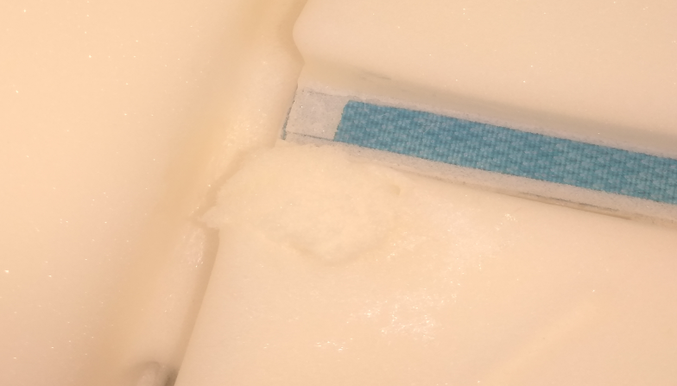
TLe Front→ ZONE A
Foam Defect Catalog
A-4
Defect reason | RP-02 Missing material
Size H/W/D [mm] | 20/30/15
Manifestation | Hole when cover is used
Repair
NG
OK
TLe Front
Project
A
1
2
3
4
TLe

Slide 9
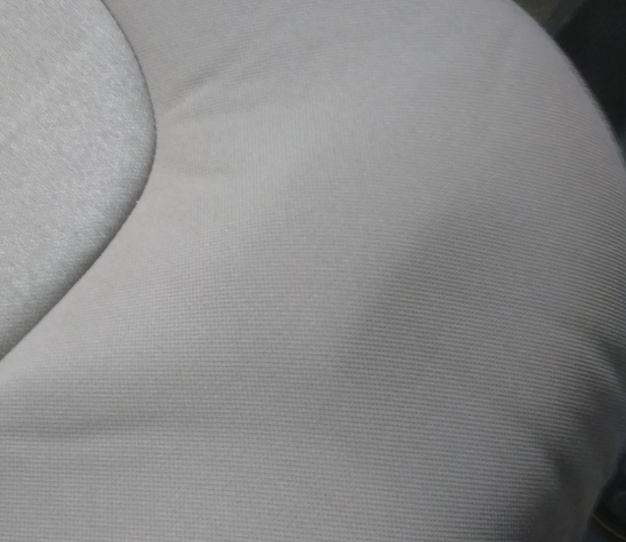
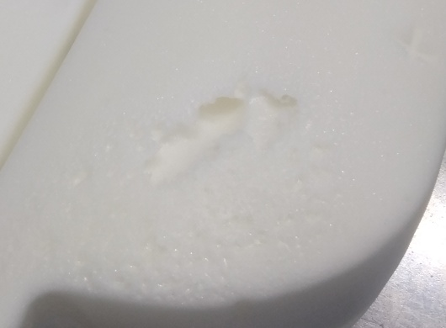
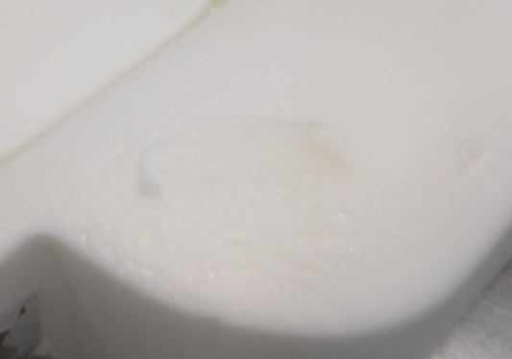
TLe Front → ZONE B
Foam Defect Catalog
B-1
Defect reason | RP-02 Missing foam
Size H/W/D [mm] | 40/15/15
Manifestation | Bulge when cover is used
Repair
NG
NG
OK
TLe Front
Project
B
1
2
TLe

Slide 10
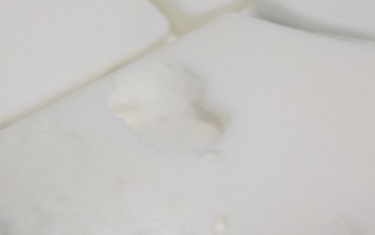
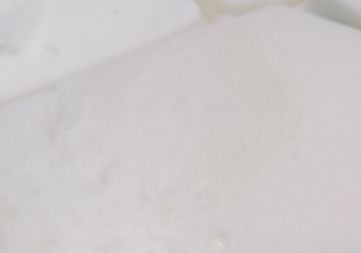
TLe Front → ZONE B
Foam Defect Catalog
B-2
Defect reason | RP-02 Missing foam
Size H/W/D [mm] | 30/30/15
Manifestation | Bulge when cover is used
Repair
NG
NG
OK
TLe Front
Project
B
1
2
TLe

Slide 11
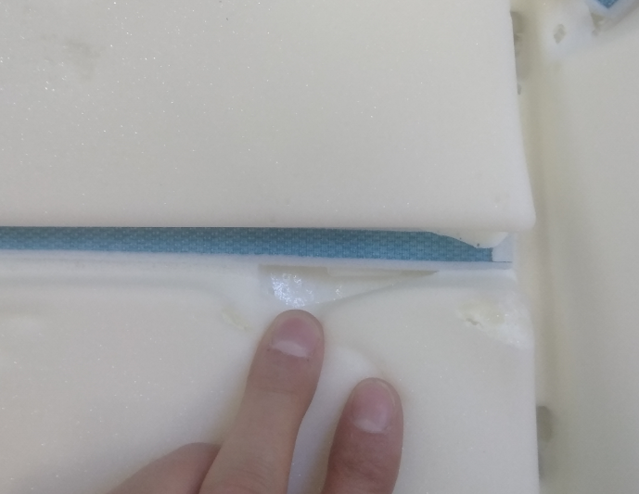
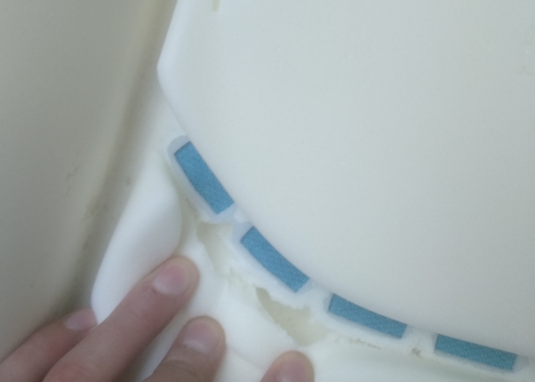
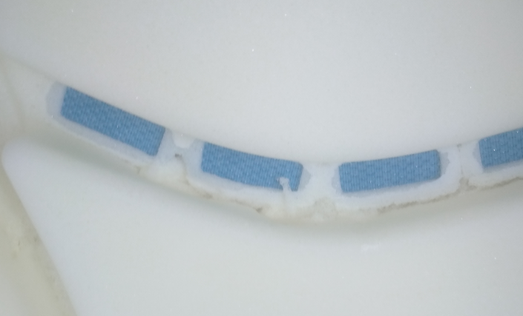
TLe Front → ZONE C
Foam Defect Catalog
C-1
Defect reason | RP-02 Missing material
Size H/W/D [mm] | 15/15/20
Manifestation | Hole when cover is used
Repair
NG
OK
TLe Front
Project
C
1
2
TLe

Slide 12
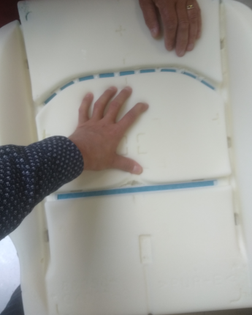
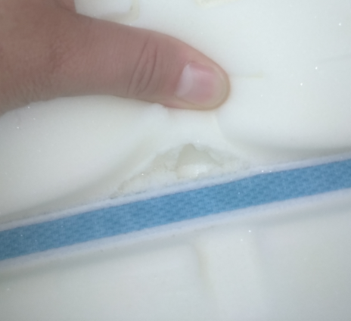
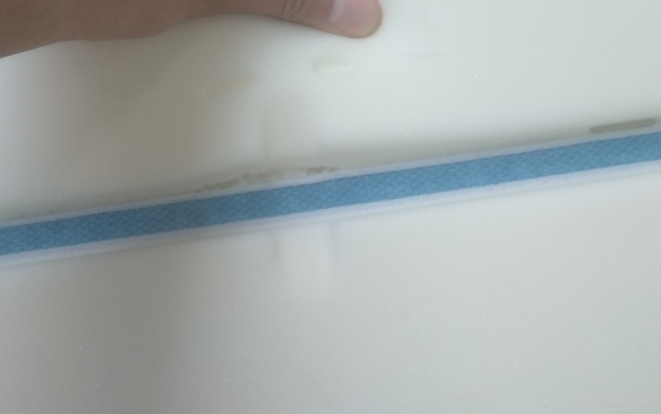
TLe Front → ZONE C
Foam Defect Catalog
C-2
Defect reason | RP-02 Missing material
Size H/W/D [mm] | 15/15/20
Manifestation | Hole when cover is used
Repair
NG
NG
OK
TLe Front
Project
C
1
2
TLe

Slide 13
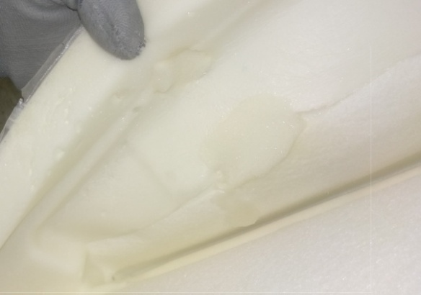
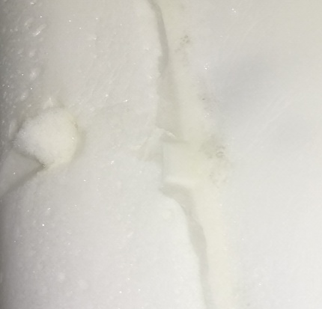
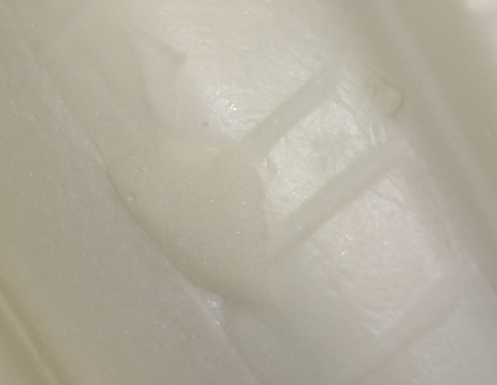
TLe Front → ZONE D
Foam Defect Catalog
D-1
Defect reason | RP-01 Hole under suface
Size H/W/D [mm] | 20/15/15
Manifestation | Surface cover deformation
Defect Foam
Defect Seat
Repair
NG
NG
OK
TLe Front
Inner Look
Outer Look
Project
D
1
2
3
4
5
TLe

Slide 14
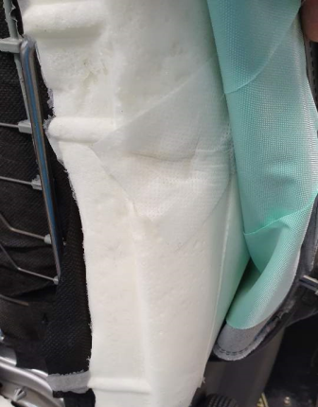
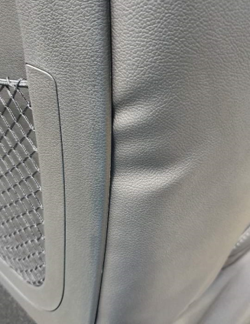
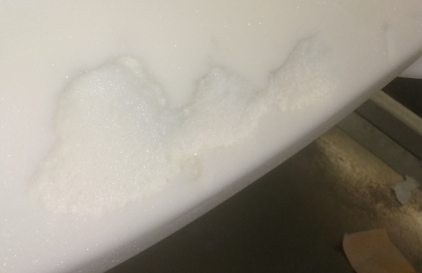
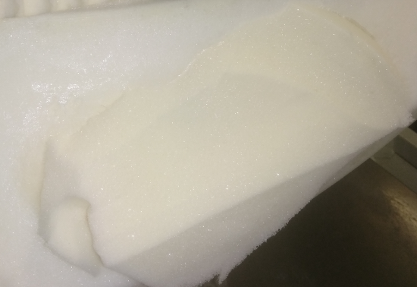
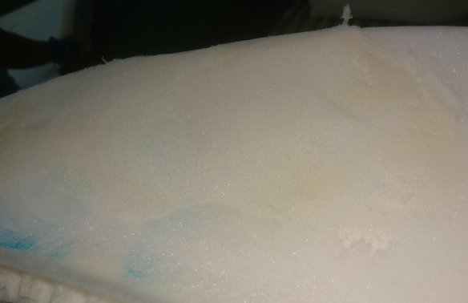
TLe Front → ZONE D
Foam Defect Catalog
D-2
Defect reason | RP-06 Deformation
Size H/W/D [mm] | 25/100/10
Manifestation | Wrincled and deformated cover
Repair
NG
NG
OK
TLe Front
Project
D
1
2
3
4
5
TLe

Slide 15
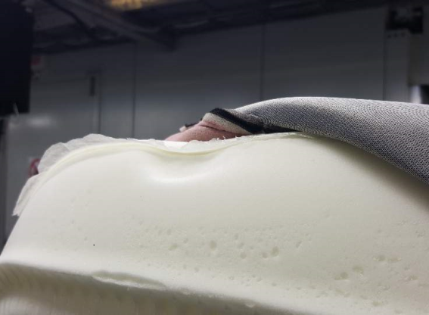
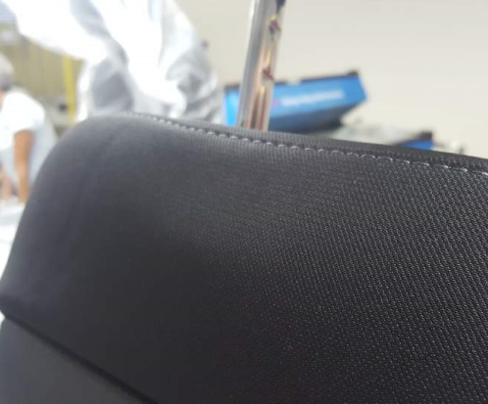
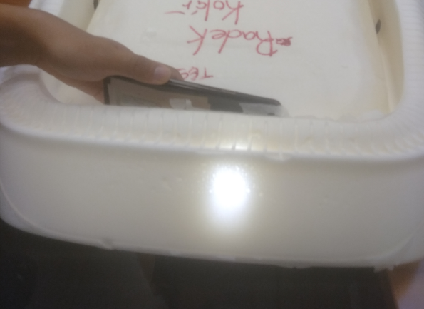
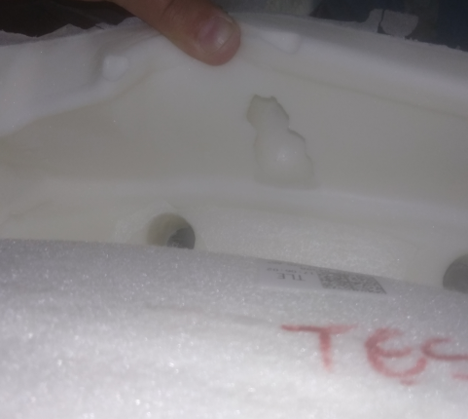
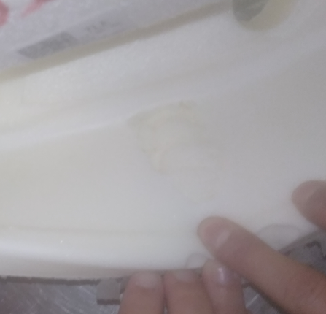
TLe Front → ZONE D
Foam Defect Catalog
D-3
Defect reason | RP-02 Missing material
Size H/W/D [mm] | 60/25/45
Manifestation | Hole and wrinkles when cover is used
Repair
NG
NG
OK
TLe Front
Project
D
1
2
3
4
5
TLe

Slide 16
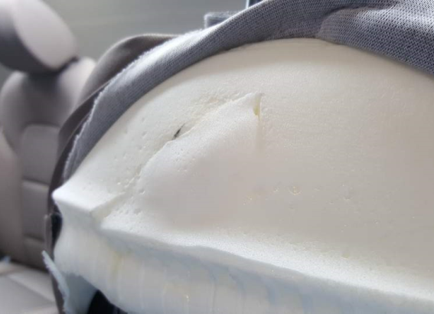
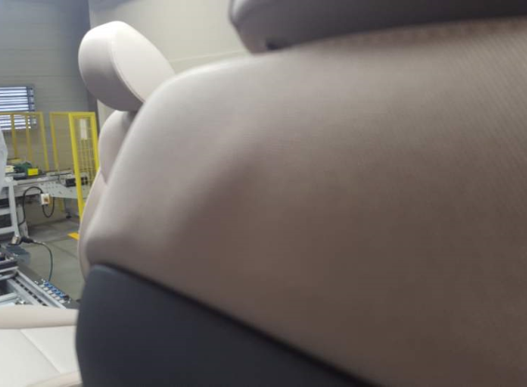
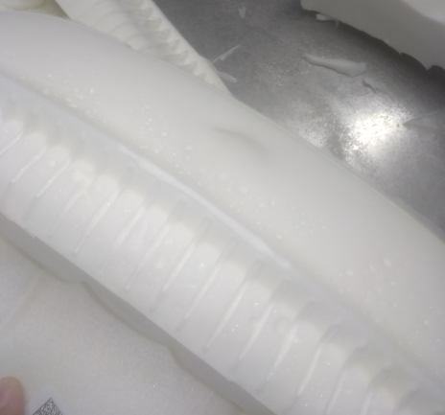
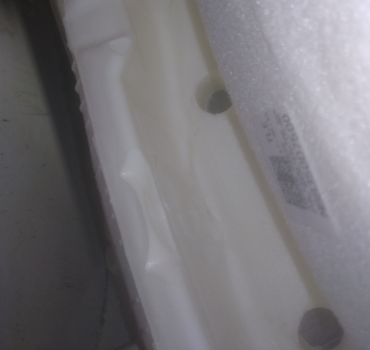
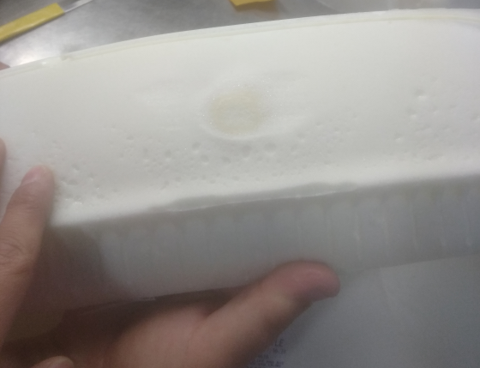
TLe Front → ZONE D
Foam Defect Catalog
D-4
Defect reason | RP-0X Wrong repair
Size H/W/D [mm] | 20/15/15
Manifestation | Bulge when cover is used
Description- Technically, rework has been done correctly- foam is warm and soft and after cool down gets harder so BULGE appears
Repair
NG
NG
OK
TLe front
Project
D
1
2
3
4
5
TLe

Slide 17
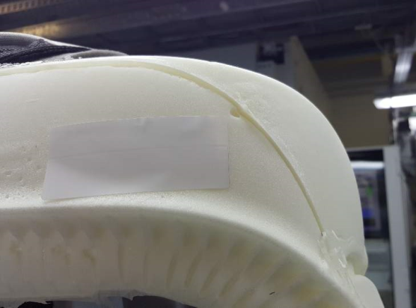
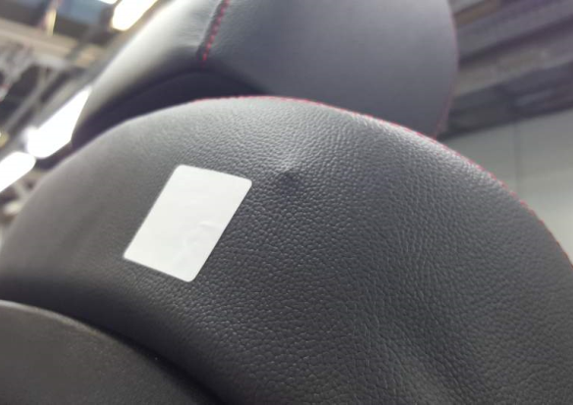
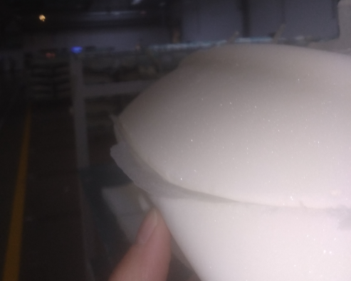
TLe Front → ZONE D
Foam Defect Catalog
D-5
Defect reason | RP-04 Overflow
Size H/W/D [mm] | 20/15/15
Manifestation | Hard overflowed foam
Repair
NG
NG
OK
TLe Front
Project
D
1
2
3
4
5
TLe

Slide 18
TLe Front Equipment
Foam Defect Catalog
SAB
Heater Back
Heater
Cush
TLe Front
SBR
Project
TLe

Slide 19
TLe Front Equipment
Foam Defect Catalog
SAB-1
Official OK
Red zone (SAB) HAS TO be with NO defect
Max possible repair 15x10 mm
Deffect over 15x10 mm=SCRAP
Torn foam SAB area NG (Img 1;3)
Official OK
1
NG
2
NG
3
NG
4
NG
Hole through
TLe Front
Project
SAB
1
Equipment

